Slide 1











Climate Change:
Causes and Effects
Viktorija ŠIlinskienė

Slide 2
Learning objective:
You will develop communication and collaboration skills by analyzing the causes and impacts of climate change, while reflecting on people daily habits and the contributions of human activities.

Slide 3
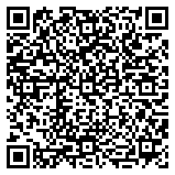
WHAT DO WE KNOW ABOUT CLIMATE CHANGE?
https://shorturl.at/wBZ05

Slide 4
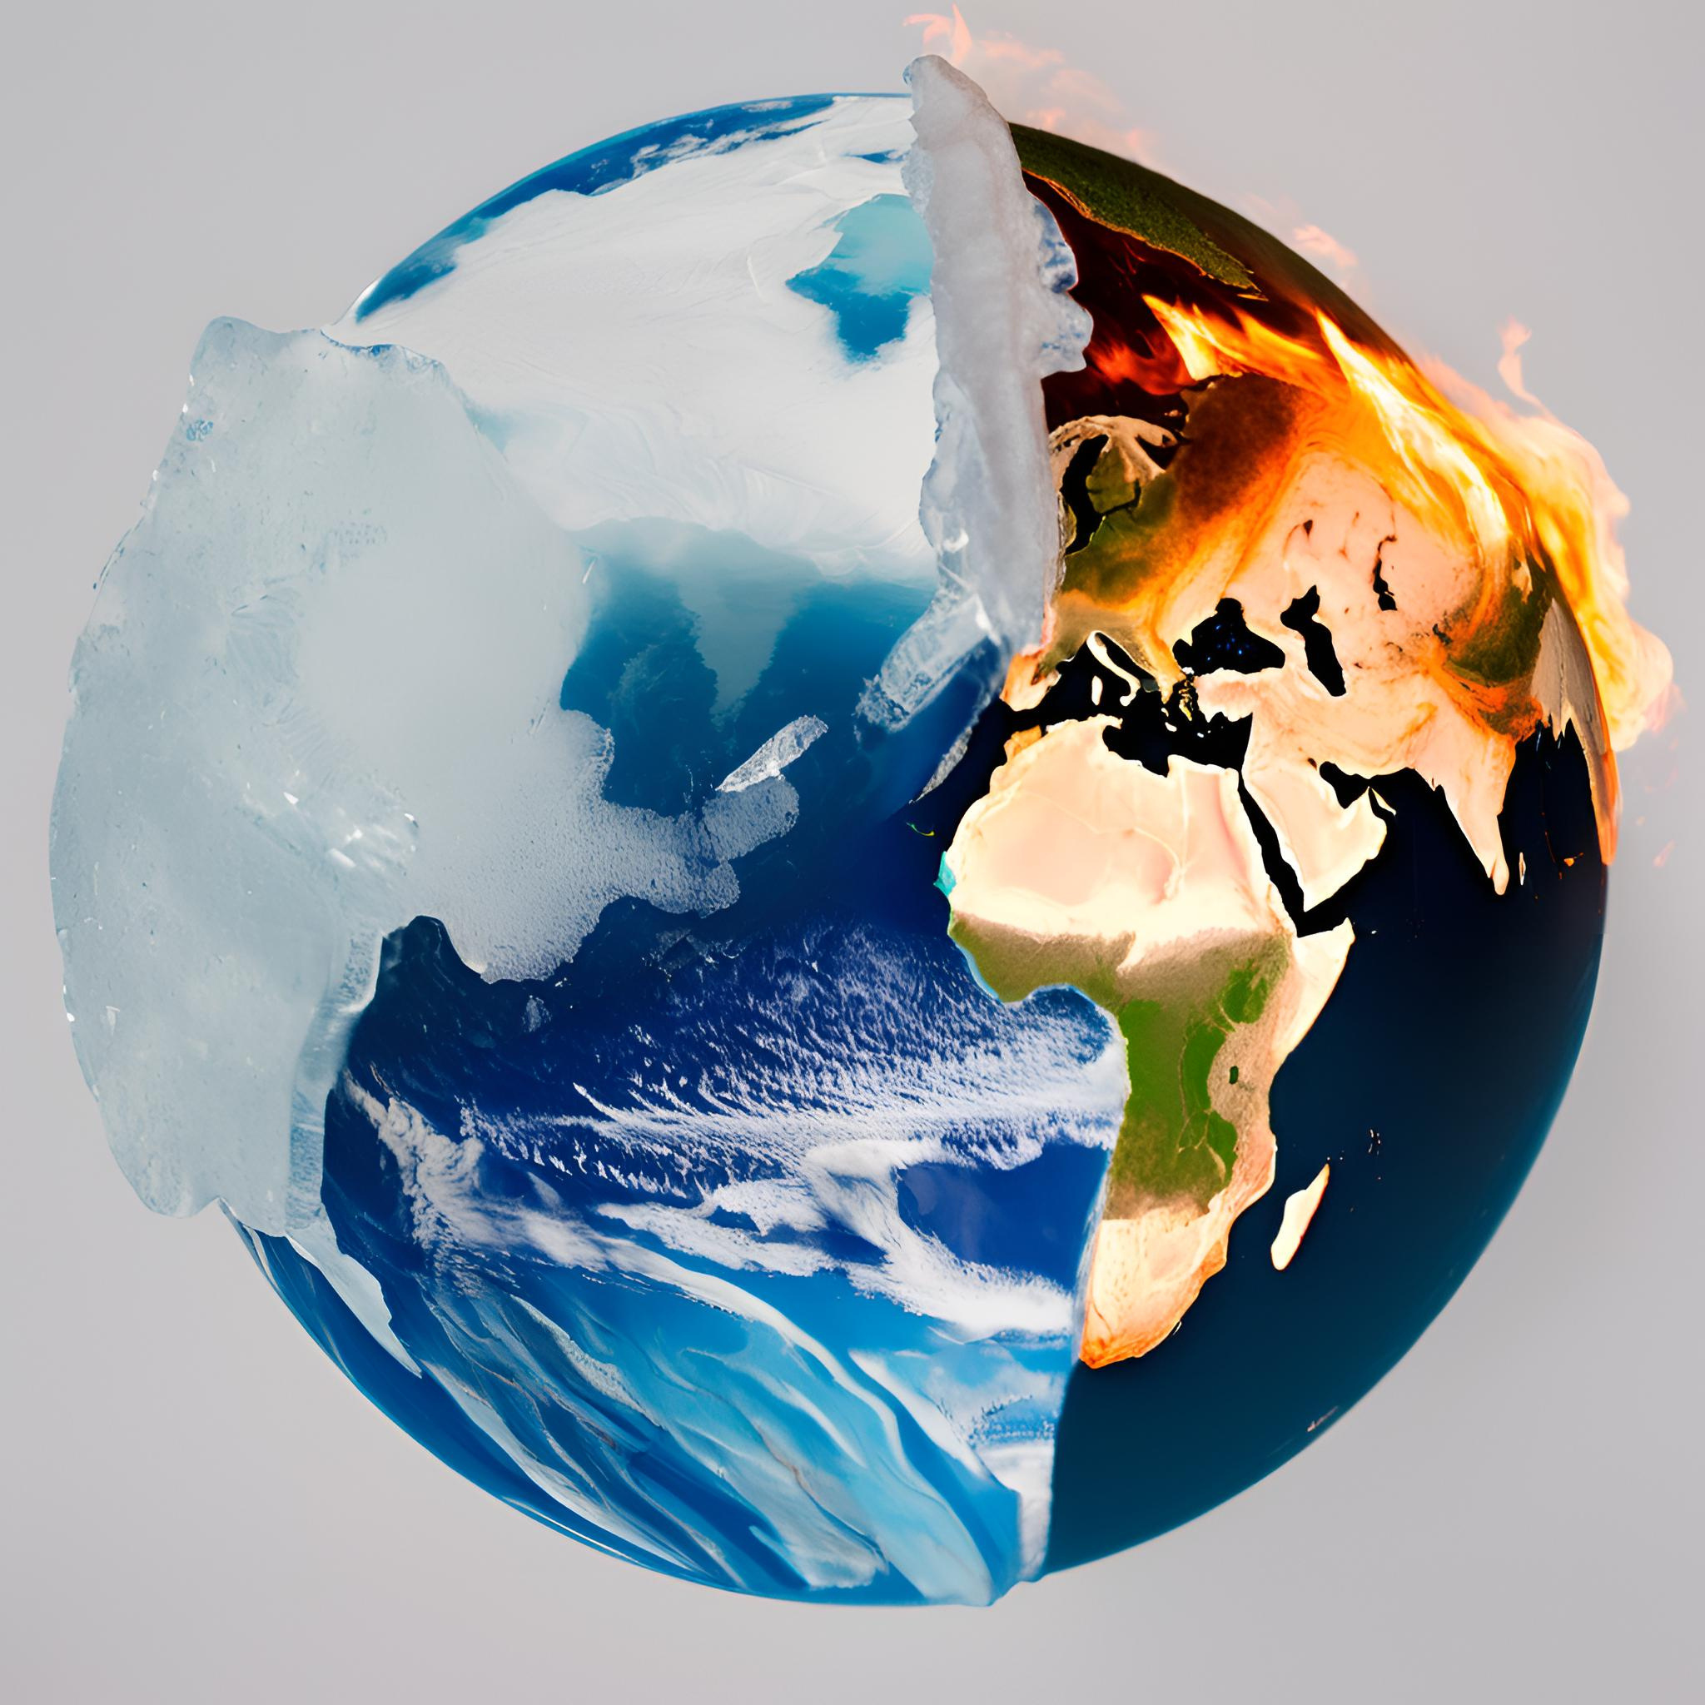
1 What is Climate Change?
Climate change refers to long-term shifts in temperature and typical weather patterns in a place. These shifts can include changes in average temperatures, rainfall, snowfall, wind patterns, and the frequency and intensity of extreme weather events like heat waves, droughts, floods, and storms.
Climate has changed in the geological past, and more than once. The Earth has been covered by glaciers, replaced by warming, and what is now land, or part of it, was once the bottom of the sea or even the ocean. This change is still happening today, and scientists say we are living in an interglacial
Notes:
• Long-term: Climate change is not just about a few hot days or a cold winter. It's about sustained changes in weather patterns over decades or even centuries.
• Shifts in temperature: The average global temperature is rising, and this warming trend is disrupting weather patterns around the world.
• Impacts weather patterns: Changes in temperature affect things like rainfall, snowfall, and wind patterns. This can lead to more frequent and intense droughts, floods, heat waves, and storms.
• Global issue: Climate change is not a problem confined to a single location. It's a global issue that affects all living things on Earth.

Slide 5

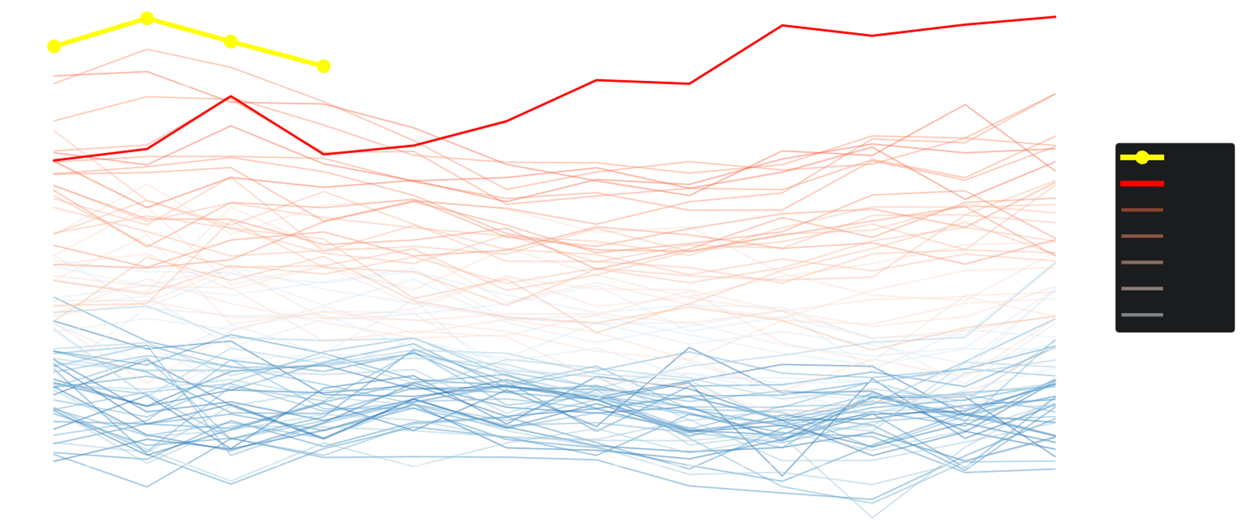

Monthly global surface air temperature anomalies
Data: ERA5 19402024
Reference period: 1850-1900
Credit: C3S/ECMWF
2.0
April 2024
2023
1.5
2024 2023 2020s 2010s 2000s 1990s 1980s
1.0
Temperature anomaly (°C)
0.5
All other years since 1940
Reference for preindustrial level (1850-1900)
0.0
Jan
Feb
Mar
Apr
May
Jun
Jul
Aug
Sep
Oct
Nov
Dec
Notes:
The Earth's average surface temperature is currently 1.5 °C warmer than 250 years ago.
This is about ten times faster than the second fastest warming in Earth's history at the end of the Ice Age. Globally, the climate crisis is causing more and more damage, and measures to halt or slow this process are increasingly
are still too few.

Slide 6
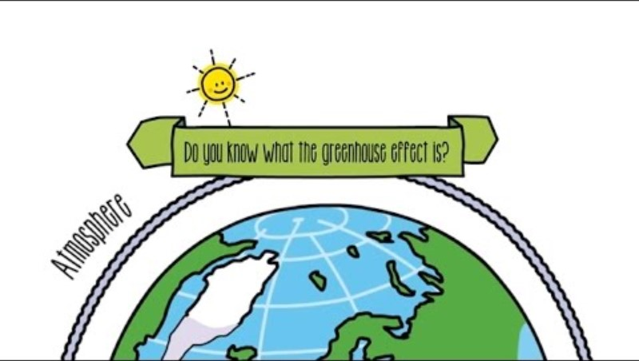
The Greenhouse Effect

Slide 7
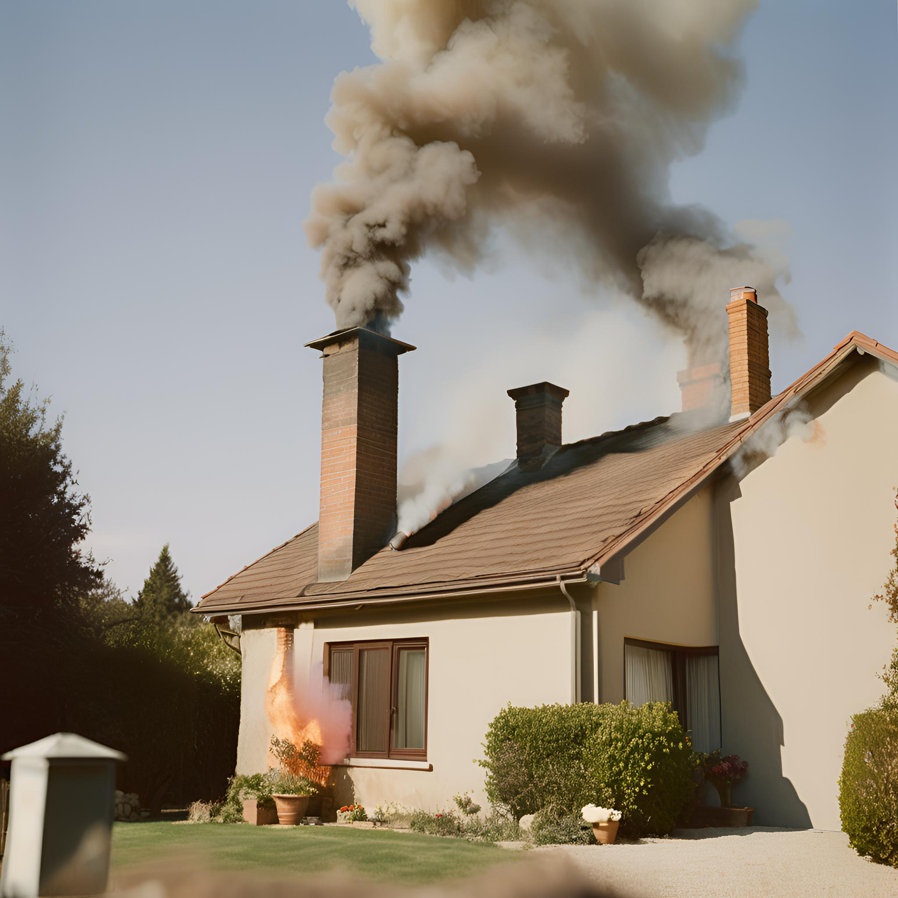
How much do you spew?

Slide 8

Answers

Slide 9
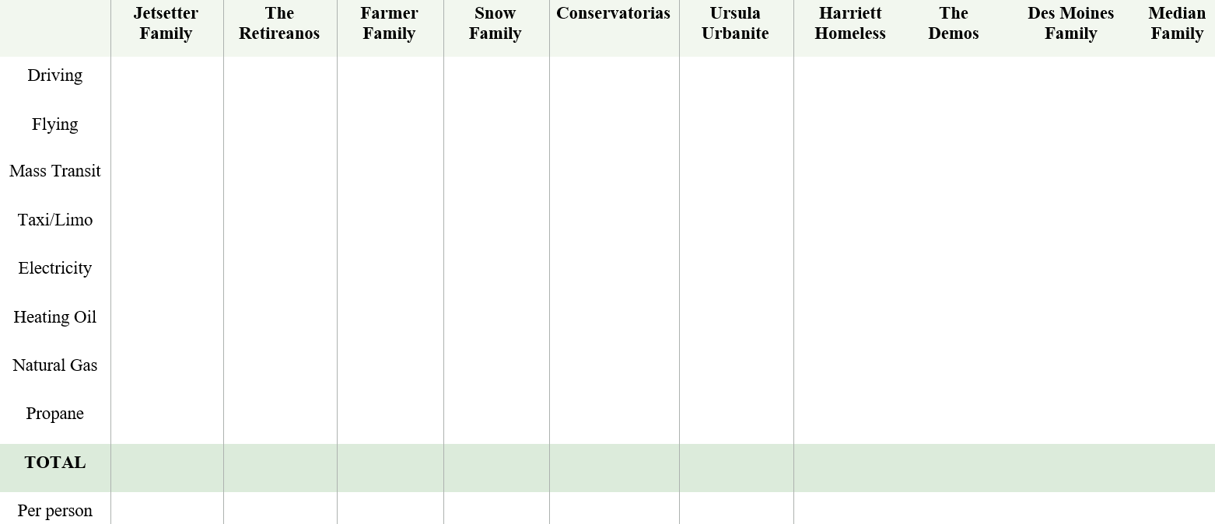

Slide 10
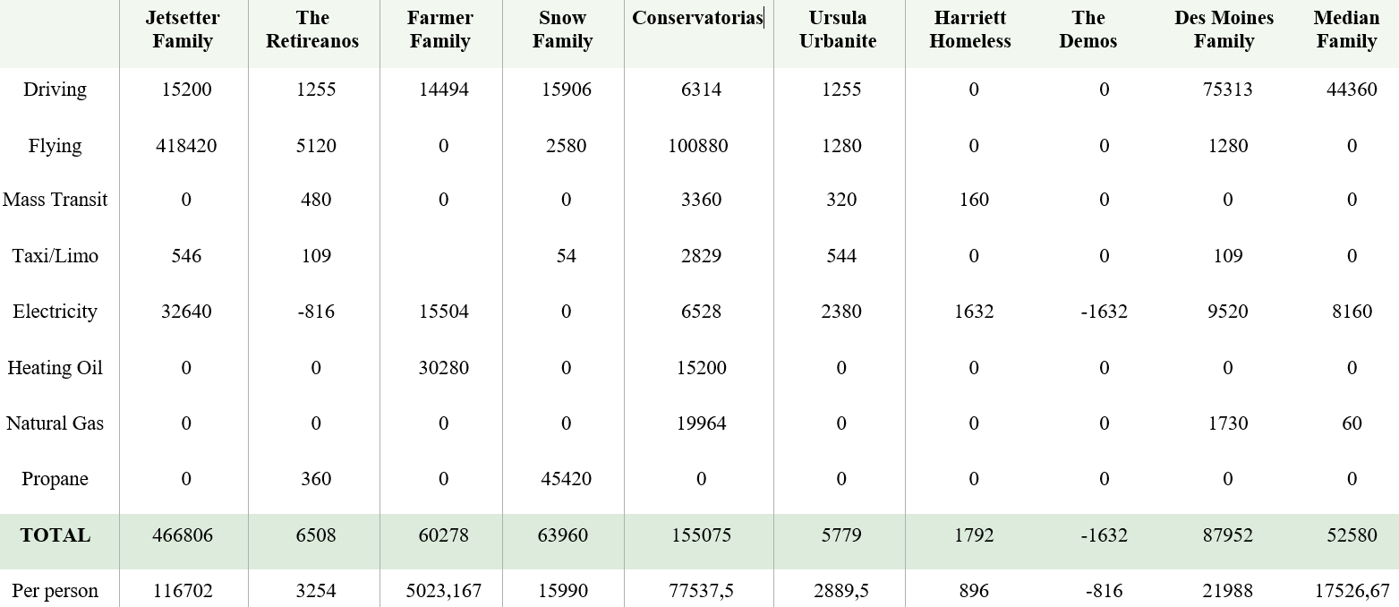

Slide 11
Let discuss
  The Kyoto Protocol recommended that emissions be reduced to at or below 1990 levels. That means less than 5000 kilograms of CO2 per person per year.
  Is the family you analyzed meeting that goal?
  What activities emitted the most CO2 for the family you examined?
  Could those activities be changed to emit less CO2 ? How?
  How would you change your scenario to reduce CO2 ?

Slide 12
Conclusion and reflection

Slide 13
Sources:
https://klimatokaita.lt/klimato-kaita/
https://www.youtube.com/watch?v=yU3GwJu_yNA&ab_channel=ACCIONA
https://scied.ucar.edu/activity/co2-how-much-do-you-spew
https://wmo.int/media/news/global-temperature-record-streak-continues-april

