Slide 1

TAKING ACTION AGAINST CLIMATE CHANGE

Slide 2

LEARNING OBJECTIVES
Today you will collaboratively research, develop, and present solutions to reduce climate change, demonstrating your understanding of the causes and effects while fostering a sense of agency in taking action.

Slide 3


WHAT DO WE ALREADY KNOW ABOUT CLIMATE CHANGE?

Slide 4
Project task
HOW TO MITIGATE CLIMATE CHANGE?

Slide 5

Projects criteria
The group must consist of at least 5 people
The project must address a climate change mitigation approach
A project outline that includes their proposed solutions, the benefits of implementing these solutions, and potential challenges.
You must read at least 2 sources
Presentation must have visual information
The presentation must be no longer than 2 minutes

Slide 6
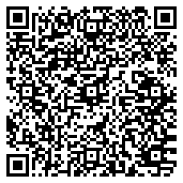
Reflectiom
WHAT COMPETENCES HAVE YOU IMPROVED TODAY?
https://shorturl.at/bcKW4

